Slide 1


Group – 1
Manjunath M A
Tejaswini Shreyas Kurumbhatte
Hrishikesh Manohar Dhondge
Syed Yaseen
Akash Roshan R
Rohith KC
PROJECT MENTORS
Asif Ahmad Yaragudi
B Harish

Slide 2

contents
INTRODUCTION/SUMMARY
KPI LIST
EXCEL – DASHBOARD
TABLEAU – DASHBOARD
POWER BI – DASHBOARD
SQL QUERIES – KPIS
KEY TAKEAWAYS
RECOMMENDATIONS

Slide 3

INTRODUCTION/SUMMARY
By Manjunath M A

Slide 4
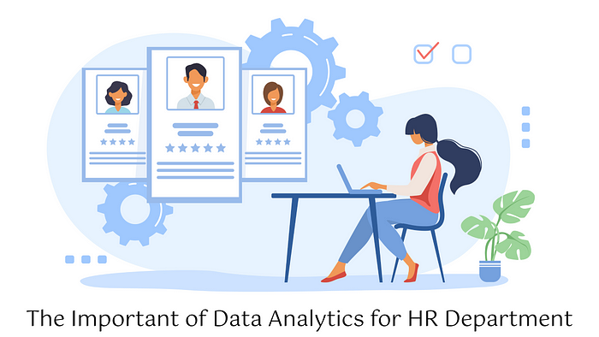
1. SUMMARY ABOUT THE PROJECT
Project Tittle : P869 Insurance Analytics
Project Summary :
This project is about analyzing the weekly performance of branch in an insurance company.
We used Excel, Tableau, and Power BI, MySQL to create dashboards that show how branch and employee is performing.
We used data from six sources: Invoice, Budget, Meeting, Opportunity, Brokerage, and Fees.
We have created a dashboard to help the corporate team and branch heads to easily track their business and employee's performance of the branch.

Slide 5

Project Goal:
Our goal was to help the corporate team and branch managers understand:
How many policies are being sold (New, Renewal, Cross-Sell)
Which employees are performing well or need support
How many client meetings are happening
Which sales opportunities are still open and need follow-up
Which products are selling more or less

Slide 6
2. KPI LIST
2. Yearly Meeting Count
3.1 Cross Sell - Target, Achieve, Invoice
3.2 New - Target, Achieve, Invoice
3.3 Renewal - Target, Achieve, Invoice
1. Number of Invoice by Account Executives
KPI
6. Top Open Opportunity
4. Stage Funnel by Revenue
5. Number of meeting By Account Executives

Slide 7
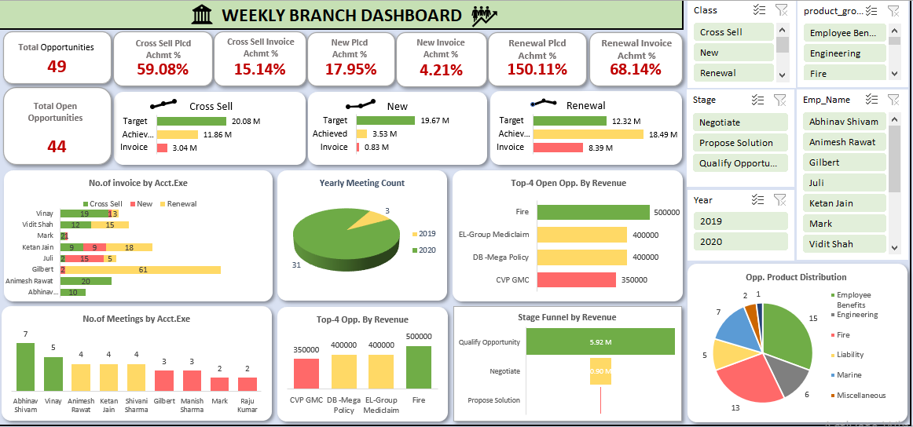
excel – DASHBOARD
By Tejaswini Shreyas Kurumbhatte

Slide 9
3. EXCEL Challenges & SOLUTIONS
Challenge 1: Understanding the dataset and unknown business terms
Solution: Took time to gain domain knowledge by studying insurance-related terminology and processes.
Challenge 2: Difficulty connecting data from multiple tables Solution: Used a Star Schema model to design structured relationships.
Challenge 3: Data cleaning and transformation requirements Solution: Utilized Power Query to clean, filter, and reshape data before analysis.
Challenge 4: Building Pivot Tables for analysis and summarization
Solution: Created Pivot Tables to quickly group data, calculate metrics, and filter business segments.
Challenge 5: Designing a clear and interactive dashboard Solution: Used Pivot Charts, Slicers, and Conditional Formatting to create dynamic dashboards.

Slide 10
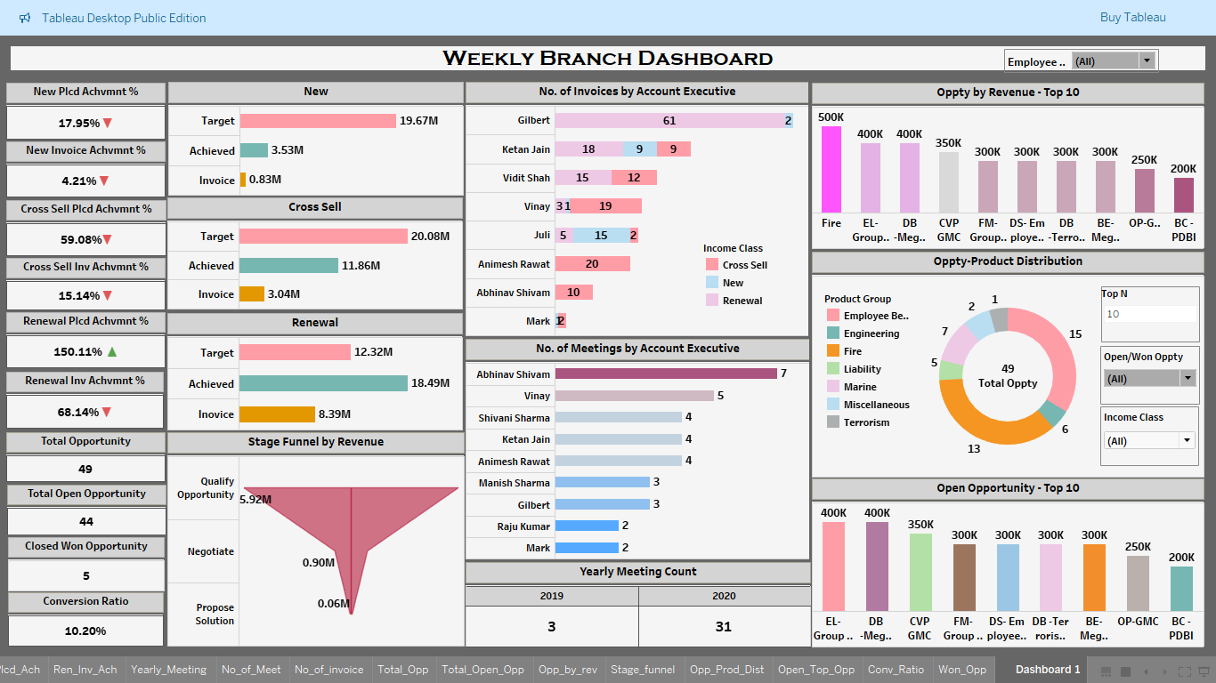
TABLEAU – DASHBOARD
By Hrishikesh Manohar Dhondge

Slide 12
4. Tableau Challenges & solutions
Challenge 1: Data spread across multiple tables: Data was scattered across 6 different datasets. Solution: Used Data Motel Optimization, i.e. Used Logical layer joins with common column account_exe_id.
Challenge 2: Target vs. Achieved logic was complex Solution: Used consistent income_class categories and created clear calculated fields in Tableau.
Challenge 3: Dashboard was slow Solution: Used aggregated extracts and optimized joins to improve performance.
Challenge 4: Business users needed simple visuals Solution: Designed clear KPI summaries, used filters, and added brief insights.
Challenge 5: Up/down arrows for KPI performance Solution: Used calculated fields + logic for formatting in Tableau.
Challenge 6: Funnel and donut charts were difficult to build Solution: Used dual-axis technique, zero axes and calculated fields to create smooth visuals.

Slide 13
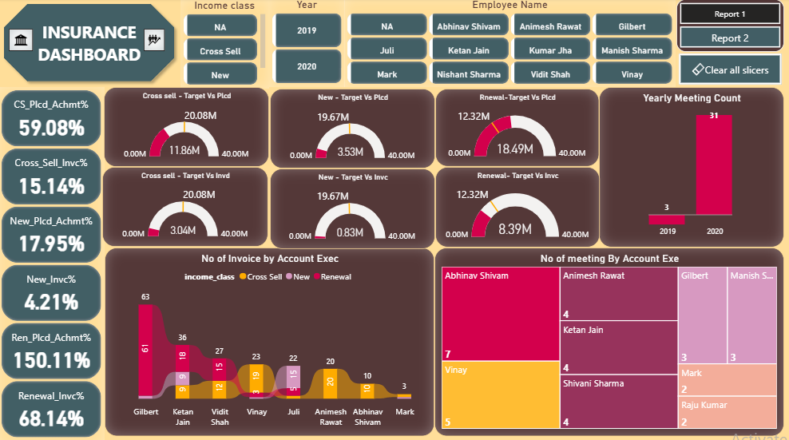
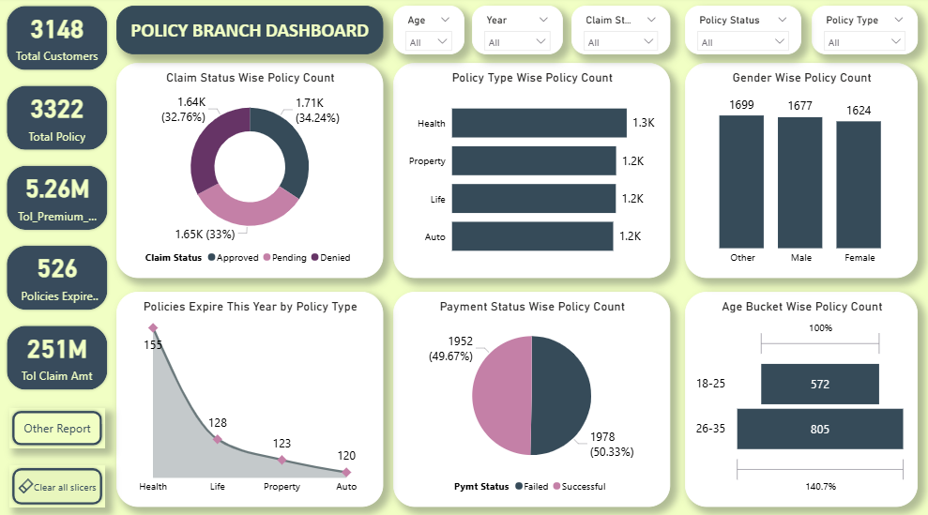
POWER BI – DASHBOARD
By SYED YASEEN

Slide 15
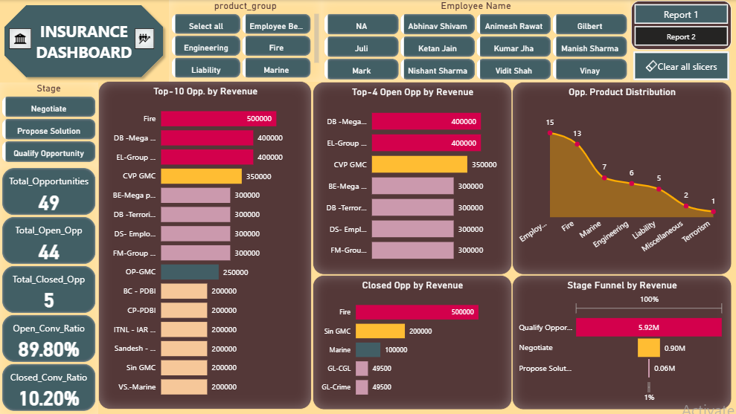

Slide 17
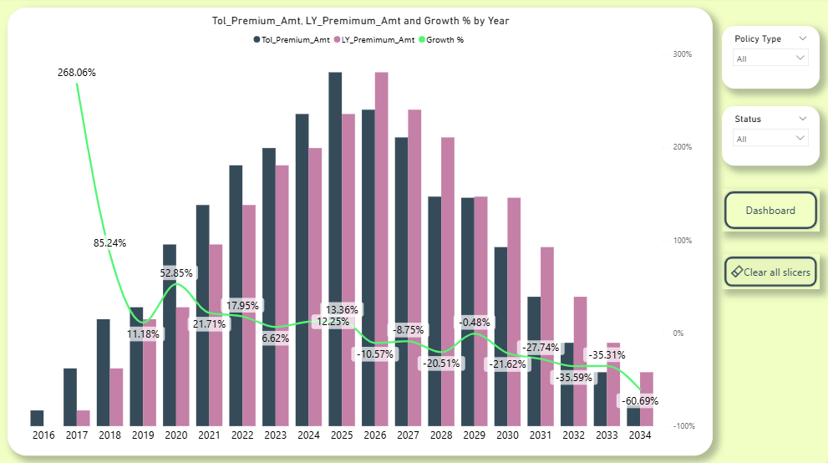

Slide 18
5. POWER BI Challenges & solutions
Challenge 1: Insufficient Space Solution: Bookmark & Page Navigation.
Challenge 2: Try to apply Conditional formatting to the Cards Solution: Created Measures using DAX functions.
Challenge 3: Target vs. Achieved logic was complex Solution: Used consistent income class categories and created clear measures using DAX functions.
Challenge 4: Business users needed simple visuals Solution: Designed clear KPI visuals, used slicers, and bookmarks.
Challenge 5: The challenges which we faced while using excel and tableau. Solution: Power BI

Slide 19

Sql QUERIES – KPI’S
By AKASH ROSHAN R

Slide 20
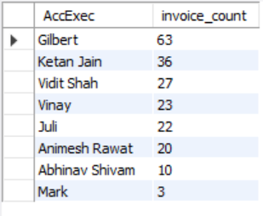




KPI LIST
1-No of Invoice by Account Exec
2-Yearly Meeting Count
3.1Cross Sell--Target, Achieve, new
3.1New-Target,Achive,new
3.1Renewal-Target, Achieve , new

Slide 21
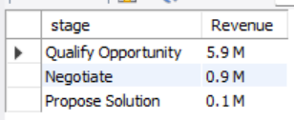
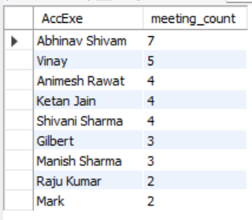
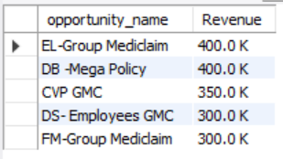
4. Stage Funnel by Revenue
5. No of meeting By Account Exe
6- Top Open Opportunity

Slide 22
6. MYSQL Challenges & SOLUTIONS
Challenge 1: Column and Table Name Issues Solution: Changed the Table names and Column Names such that there are no Special Char or Spaces
Challenge 2: Difficulty formatting large numbers in millions/billions. Solution: Used Round() and Concat() functions to get the desired output
Challenge 3: Excel date formats not recognized correctly in SQL. Solution: Converted Excel date fields to standard YYY-MM-DD format before importing.
Challenge 4: Group BY clause in stored procedures threw errors due to non-aggregated columns. Solution: Included all non-aggregated columns from Select in the Group BY clause to ensure it worked.
Challenge 5: SQL doesn't support dashboard-style dynamic filters.
Solution: Used stored procedures with input parameters to simulate filters and return dynamic results.

Slide 23
7. Key Takeaways
KEY BUSINESS INSIGHTS
4. Sales Funnel Drop-Off Detected
Qualify Stage: ₹5.92M
Proposal Stage: only ₹0.06M
Indicates poor conversion beyond early stages
5. Product Mix Skewed
High focus on Employee Benefits (15) and Fire (13)
Underutilized: Marine (7), Engineering (6)
6. Open Opportunities
The top 5 open opportunities are all high-value deals ranging from ₹300K to ₹400K, primarily in Group Mediclaim and Mega Policy segments.
These represent a significant revenue potential and should be treated as high-priority follow-ups in the short term.
1. Renewal Business is performing strongly
Achieved ₹18.49M vs. Target ₹12.32M (150.11% achievement)
Invoice Realized: ₹8.39M (68.14%)
2. New and Cross-Sell Business need improvement
New Achieved: ₹3.53M out of ₹19.67M (17.95%)
Cross-Sell Achieved: ₹11.86M out of ₹20.08M (59.08%)
Invoice achievements under 20% for both
3. Top Performers Identified
Gilbert, Vinay, and Abhinav contributed the most invoices and meetings

Slide 24
8. RECOMMENDATIONS
Upskill Account Executives in New and Cross-Sell to close the performance gap.
Optimize funnel efficiency between Qualification and Proposal stages.
Focus on closing large open opportunities (e.g., Mediclaim: ₹400K+).
Set a weekly client meeting target to drive consistent engagement.
Promote underused product lines like Marine & Engineering through cross-sell.
Use tools like MySQL and BI dashboards for real-time decision-making.

Slide 25
THANK YOU
ANY QUERIES ??

